Slide 1
CS 2033 Multimedia & Communications II
Lecture 4 – cascading STYLE sheets (CSS)

Slide 2
CSS
Cascading Style Sheets
CSS is used only to style websites.
This is the standard for styling and goes hand in hand with HTML.
Used for layouts/positioning of elements and their appearance, like colour, font colour, border, etc.

Slide 3

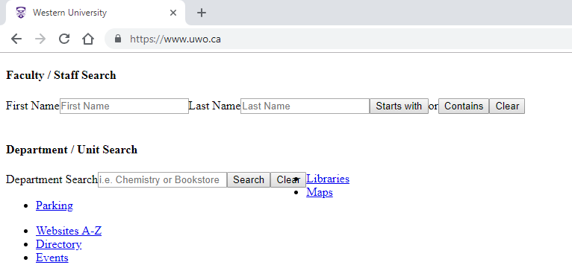
CSS
With CSS
Without CSS

Slide 4
CSS
Remember that divs and many other HTML elements can be nested within one another.
This is helpful for creating layouts.
This relationship is known as parent-child, where the parent is the container / outer element and the child is the inner element.

Slide 5
CSS
What styles can be applied in CSS?
Tons! You'll need to know the common ones but not all of them.
How are they applied?
3 main ways to apply the basic styles (more for advanced styles).
Where does CSS code go?
3 different placement options.

Slide 6
Style types
Layout
Width, height
Position type
Position values
Display type / float
Margins and padding
Top, right, bottom, and left (I call these TRBL or "trouble" ☺)

Slide 7
Style types
Appearance
Background colour
Background image/texture
Font colour
Border style
Rounded corners
Opacity

Slide 8
Style types
Many styles overlap both categories but I try to label them by their primary function.
i.e. size is used for layout but also impacts the appearance.
Some styles only work if other styles are set in a certain way.
You will see this very soon when we discuss positioning.

Slide 9
Layout-based styles
Width and height are simple.
Padding is the space just inside the element, keeping its contents away from the edge.
Margin is the space outside the element, keeping it away from other elements.
Most size styles are in px or %.

Slide 10
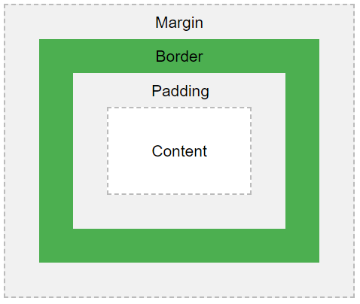
Layout-based styles

Slide 11
Layout-based styles
Positioning elements can be done a few ways (or a combination).
By default, elements are added sequentially top to bottom.
Depending on size and layout styles, they may be added left to right in a row too.

Slide 12
Layout-based styles
The position style type determines how (but not where!) the element is positioned in the page or its parent.
The default value is static, meaning it's added sequentially in the site and cannot be moved.

Slide 13
Layout-based styles
Other position options are:
Relative – similar to static but can be shifted with TRBL values.
Absolute – location is directly based on TRBL values within its parent!
Fixed – location is locked in place.
Sticky – position changes between relative and fixed on scrolling.

Slide 14
Layout-based styles
Top, right, bottom, and left (TRBL) can be set, but their behavior depends on the position type.
No effect on static position.
Think of this as a Cartesian plane grid, with the top-left corner being (0,0) in terms of (left,top).
You can start from any corner though! Use either T or B, and either L or R.

Slide 15
Layout-based styles
In addition to position, another way to affect layout is with display.
There are several possible values for this but the most important ones for now are:
Block – takes up entire row.
Inline-block – can be placed in row.
None – not added to page.

Slide 16


Layout-based styles
If you want to place elements side by side, then try inline-block.
Inline-block display
Block display

Slide 17
Layout-based styles
Positioning and creating layouts with CSS can be complex.
We will discuss this topic in more detail next week.
For now we are still going through the basics of CSS styles.

Slide 18


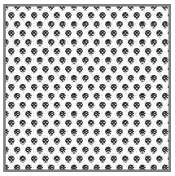

Appearance-based styles
Background can be a solid colour, gradient, transparent, or an image.
For a texture/image, you can also set whether it should be repeated (tiled), its size, and position.

Slide 19





Appearance-based styles
Font colour can be any solid color.
Border styles have 3 parts:
Colour
Width
Line type (solid, dotted, etc.)

Slide 20




Appearance-based styles
Corners can be square or rounded.
Rounding values are usually in px.
If you use really high rounding values, you can create a circle ☺
If width = height and the rounding value is at least half of that width.

Slide 21
Colours
Several style types are based on colour (i.e. background colour, font colour, border colour).
They can be hexadecimal or RGB codes. A lot of popular colours can also be called by name! Transparent is another option.
http://www.html-color-names.com/color-chart.php

Slide 22
Style examples
How are styles actually set?
property: value;
Examples:
width: 200px;
display: block;
position: absolute;

Slide 23
Style examples
Colour examples:
background-color: beige;
background-color: transparent;
background-color: #9595AA
color: yellow;
color: rgb(255,32,175)
What is color vs. background-color?

Slide 24
Style examples
Border examples:
border: solid 2px darkred;
border: rgb(0,0,50) dotted 1px;
border-bottom: solid 1px #A744B9;
border-width: 4px;
border-top-color: purple;
Lots of flexibility with borders!

Slide 25
Rule-sets
Now that we know how to make individual styles, how do we group them and apply them?
A rule-set is a group of styles for a certain selector or selectors.
There can be any number of styles within a rule-set.

Slide 26
Selectors
Wait, what are selectors?
Selectors are ways of determining which element(s) are given the styles of the rule-sets.
We're essentially indicating which element(s) we want to apply a style to and then using any combination of rules to create the overall style.

Slide 27
Selectors
Rule-sets are formatted like:
selector { property1: value1; property2: value2; … }
This will make more sense when you see the selectors.
property1: value1 represents a generic property-value style rule.

Slide 28
Selectors
There are 3 main types of selectors.
Based on tag / element type.
Based on class name.
Based on ID.
There are additional types based on the state of the element, known as pseudo-classes.

Slide 29
Tag selectors
Tag selectors apply to all elements of the specified HTML tag.
i.e. <p>, <h1>, <body>, <img>
These selectors are labelled with the tag name, as it is in HTML, but without the <> brackets.
i.e. p, h1, body, img

Slide 30
Tag selectors
p { color: red; }
body { margin: 0; }
div { background-color: #ff0000; }

Slide 31
Class selectors
Class selectors apply to all elements that are given the specified class.
HTML elements can be given a class as an attribute.
i.e. <div class='myclass'>
Classes can be applied to any number of elements and any combination of element types.

Slide 32
Class selectors
These selectors in CSS are labelled with a period (.) followed by the specific class name it applies to.
i.e. .myclass, .anotherclass
Ensure the class name is spelled identical in HTML and CSS.
i.e. <div class='my-class'> will not match the selector .myclass

Slide 33
Class selectors
.my-class { position: relative; }
.nav { margin: 5px; color: darkblue; width: 100%; height: 50px; }

Slide 34
ID selectors
ID selectors apply to the element with that ID (if there is one).
Just like classes, HTML elements can be given an ID as an attribute.
i.e. <div id='menu'>
Unlike classes, IDs must be unique and not given to multiple elements.
This is important!

Slide 35
ID selectors
These selectors in CSS are labelled with a pound sign (#) followed by the specific ID name it applies to.
i.e. #menu, #profile-picture
Ensure the ID name is spelled identical in HTML and CSS.
i.e. <div id='topmenu'> will not match the selector #menu

Slide 36
ID selectors
#menu { height: 100px; line-height: 100px; background-color: black; color: white; }
#title { font-size: 40px; }

Slide 37
Styling web forms
There are many form input types.
How can we apply a style to all/several inputs at once, or all inputs of a certain type at once?
input { } applies to all "input" tags.
Textarea is not made with an input tag so it will not be affected. ☹
Use texarea { } for these fields.

Slide 38
Styling web forms
i.e. make all form fields 200px wide.
input { width: 200px; }
textarea { width: 200px; }

Slide 39
Styling web forms
If we want the same styles applied to "inputs" and "textareas", it would be redundant to have two identical rule-sets for the two types.
Selectors can be grouped together using a comma to separate them.
input, textarea { width: 200px; }

Slide 40
Styling web forms
Grouping rule-sets is not only for form input elements but for any combination of selectors (tags, classes, and IDs).
p, input, .longtext, #login { width: 200px; color: blue; }

Slide 41
Styling web forms
How about if we want to style one specific type of input field?
CSS allows us to select based on attribute values as well!
Remember most input types are specified by the type attribute.
i.e. <input type="text" />
i.e. <input type="radio" />

Slide 42
Styling web forms
We can specify an attribute value in square brackets [ ] to select that type for a CSS selector.
input[type=text] { border: solid 2px #FA4949 }
input[type=submit] { width: 200px; }

Slide 43
Styling web forms
These can also be incorporated in grouped selectors.
input[type=submit], #title, p { color:red; }
input[type=text], textarea { font-size: 20px; }

Slide 44
Adding CSS in webpages
There are 3 ways of adding CSS to webpages:
Inline – in HTML element attributes.
Internal – in HTML head section.
External – in its own file.

Slide 45
Inline CSS
One way to add CSS is directly in HTML tags in the style attribute.
This can work well for applying a style to a single element and doing so quickly for testing purposes.
i.e. <div style='width: 50%; height:300px'>Welcome</div>

Slide 46
Internal CSS
Inline CSS is generally not a good option since it only applies to one element.
To apply styles to an entire page, you can add rule-sets into the head section of the HTML.
CSS is meta data!

Slide 47
Internal CSS
Within the head, use the <style> tag to create a place for CSS and then add the styles in there.
Works well for a single page site, or styles that only apply to one page.
Definitely better than inline styles.

Slide 48
Internal CSS
<head>
<style>
p { color: red; }
div {
width:300px;
border: solid 2px red;
}
</style>
</head>

Slide 49
External CSS
However, internal CSS is still not completely efficient.
Suppose you have a website with multiple pages and want the styles to apply to all pages.
The best option is external CSS.
Store the CSS in its own file(s) and link the webpages to the CSS file(s).

Slide 50
External CSS
External CSS is stored in files with the .css extension.
Linking these files into HTML pages is very simple:
<link rel="stylesheet" type="text/css" href="styles.css">
This is also meta information so it goes in the head section of the HTML.

Slide 51
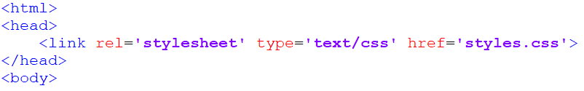
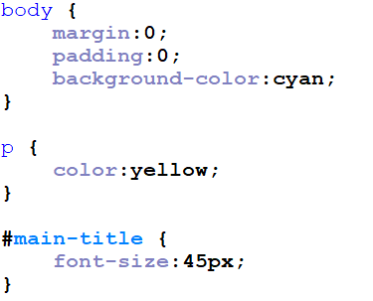
External CSS
index.html
styles.css

Slide 52
CSS rules
Styles are applied in top-to-bottom order generally.
This only matters if there are conflicting rules or rule-sets.
The order doesn't matter otherwise.
p {color: red; width: 50px; } is the same as p {width: 50px; color: red; } since the rules are independent.

Slide 53
CSS rules
So where does the order matter?
Conflicting rules within a rule-set.
Multiple rule-sets with conflicting styles applied to an element.
Let's look at examples of each.

Slide 54
CSS rules
In cases of conflicting rules within a rule-set, the bottom-most rule overrides previous ones.
p { color: red; color: blue; }
In this case, color: blue is applied only. It overrides color: red;

Slide 55
CSS rules
When multiple rule-sets are applied, it's a little more complicated.
p { color: red; } .home { color: blue; }
<p class='home'>Hello world</p>
Does the text turn red because it's a paragraph or blue because it has the 'home' class applied to it?

Slide 56
CSS rules
The class rule-set takes precedence so the text will be blue.
How about if there is an ID too?
p { color: red; } .home { color: blue; } #title {color: green; }
<p class='home' id='title'>Hello world</p>

Slide 57
CSS rules
The ID rule-set will be applied so the text will be green.
Why does this happen?
CSS rules are assigned a specificity or a priority weighting to indicate the precedence in cases of conflicting rules or rule-sets.

Slide 58
CSS rules
The specificity order (low to high) is:
Type selectors (p, div, etc.)
Class selectors (.home, etc.)
ID selectors (#title)
This is why class overrides type, and ID overrides both type and class in our examples.

Slide 59
CSS rules
There's a way to break the regular order of rule-set specificity.
The word !important immediately after a style gives it top priority.
p { font-size:24px !important; }
It's not recommended to use this unless you absolutely need to.

Slide 60
Design tips
Tips on smart website design:
Use web-safe fonts or Google Fonts.
Create a consistent and cohesive design for your website.
Limit the number of colours you use.
Ensure all text is readable.
Avoid having tons of text.
Do not center paragraphs of text.

Slide 61
Additional tips
While creating a website, use flashy backgrounds or borders to help see where elements start and end. I often use reds and yellows to help with this.
Once they are in the correct place, revert them to the colours you desire.

Slide 62

Additional tips
Sometimes you will change CSS but the change is not displayed when you refresh the browser.
Might be due to caching. Browsers save website information so that it can load quicker the next time.
To get around this, close Chrome and then open it in Incognito mode.

